Slide 1

PGPCC - Mentor session
Managed Services on AWS
Course 3 Week 3
Lambda with Application Load Balancer demonstration
Cognitive Services

Slide 2
Lambda with Application Load Balancer
The ALB has the ability to send traffic to a specific target group (TG) based on path. The default path is to send all the traffic to a given TG. Usually, a TG comprises of infrastructure components either on the cloud (EC2 instances) or from on-prem datacenter (via IP).
There is a feature by which the target group can contain a lambda function as the backend!
You can use a Lambda function to process requests from an Application Load Balancer. Elastic Load Balancing supports Lambda functions as a target for an Application Load Balancer.
Use load balancer rules to route HTTP requests to a function, based on path or header values. Process the request and return an HTTP response from your Lambda function.
Elastic Load Balancing invokes your Lambda function synchronously with an event that contains the request body and metadata.

Slide 3
Setting up the Lambda Functions
Create a new Lambda function called “PythonLambda’. Make sure to attach the pre-created role “LabRole” to the function while creating it. Use the Python 3.9 runtime for this function.
Paste the code provided in the Appendix 1 of this slide deck into the code editor of the function. Remember to click on “Deploy” to save the function.
Create another Lambda function called “NodeLambda” with the pre-created IAM role “LabRole”. Use the runtime Node.js 14.x for this function.
Paste the code provided in the Appendix 2 of this slide deck into the code editor of this function. Once again, remember to click on “Deploy” to save the function.

Slide 4
Setting up the target groups
Create a new target group called “PythonTG” and select “Lambda function” as the backend. Enable health checks with the HTTP protocol and set the path to “/lambda”. The rest of the fields can be left to their default values. Click on “Next”.
From the drop down, select the Lambda function “PythonLambda” and click on “Create Target Group”.
Create another target group called “NodeTG” with the same configuration as the previous one. When asked to select a Lambda function, select “NodeLamda” from the dropdown.

Slide 5
Setting up the load balancer -1
Create a new security group called “LB-SG”. Ensure that it has port 80 open for all incoming connections from all sources.
Create a new Application Load Balancer. Make sure to select any two availability zones from the mappings list. Under security groups, select the “LB-SG” security group created earlier. Under Listeners, select the target group “PythonTG” from the dropdown.
The rest of the fields can be left to their default values. Click on “Create Load balancer”.
Wait for the load balancer to finish provisioning. Once the load balancer is ready, navigate to the “PythonTG” target group and ensure that the target is healthy. Then access the DNS of the load balancer using the web browser, it should display the text “Hello from Lambda!”

Slide 6
Setting up the load balancer -2
Navigate to the existing load balancer and under “Listeners”, select the existing listener and click on “Edit”
Edit the existing default action and select the target group “NodeTG” from the dropdown. Set the traffic distribution to 50% each. Click on “Update”.
Ensure that the targets for the NodeTG target group are healthy and access the DNS of the load balancer using a web browser.
Refresh the web browser window a few times and verify that the shown text switches between “Hello from Lambda!” and “Response from Lambda Web Backend” which is the output from PythonTG and NodeTG respectively.

Slide 7
Appendix 1 – PythonLambda.py
def lambda_handler(event, context):
response = {
"statusCode": 200,
"statusDescription": "200 OK",
"isBase64Encoded": False,
"headers": {
"Content-Type": "text/html; charset=utf-8"
}
}
response['body'] = """
<html>
<head>
<title>Hello Lambda!</title>
<style>
html, body {
margin: 0; padding: 0;
font-family: arial; font-weight: 10; font-size: 1em;
text-align: center;
}
</style>
</head>
<body>
<p>Hello from Lambda!</p>
</body>
</html>
"""
return response

Slide 8
Appendix 2 – NodeLambda.js
exports.handler = async (event) => {
console.log('Lambda is called from LB and the payload is');
console.log(JSON.stringify(event));
const response = {
statusCode: 200,
statusDescription: "200 OK",
isBase64Encoded: false,
headers: {
"Content-Type": "text/html"
},
body: "<h1>Response from lambda web backend</h1>"
};
return response;
};

Slide 9
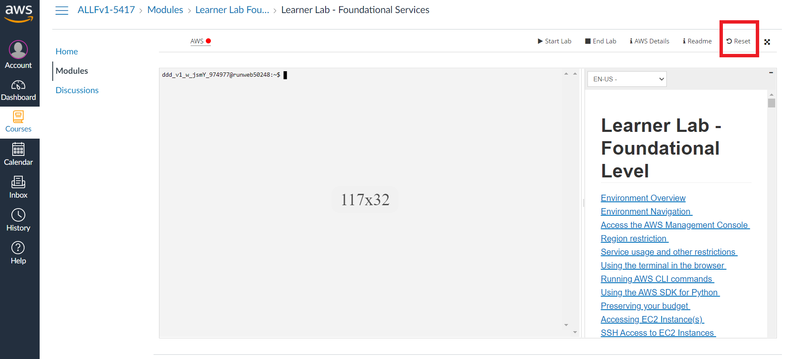
Do not forget to reset your lab

Slide 10

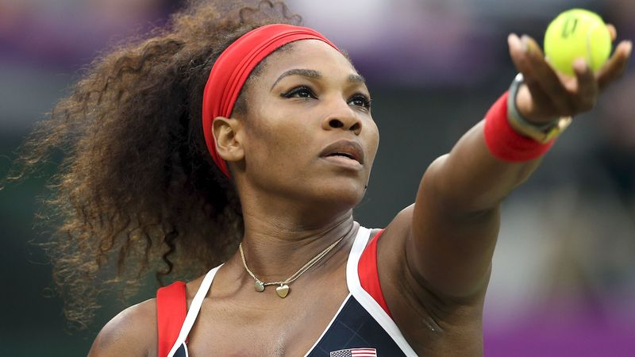



Amazon Rekognition
Managed computer vision AI service
Detects:
Objects
Scenes & videos
Faces
Text
Notes:
Rekognition makes it easy to add image and video analysis to applications.

Slide 11
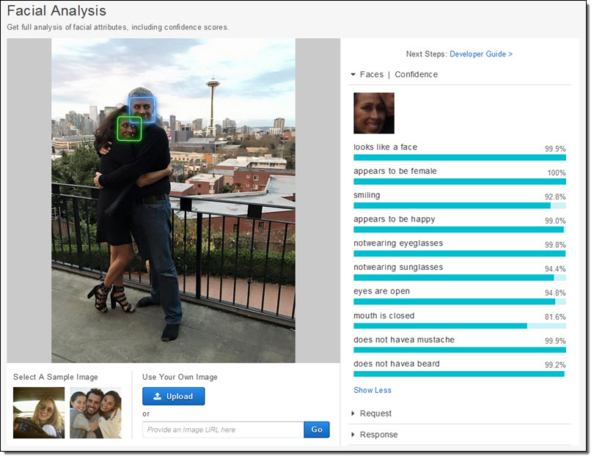
Amazon Rekognition
Some uses cases:
Identity verification
Aella Credit
Kia Motors
Workplace safety
Media analysis
CBS Content Moderation
Industry & Retail
Notes:
Example use cases:
Identity verification - Virtual proctoring (taking exams), customer and access verification (automated check-in and hospitality).
Leverages computer vision for:
Test taker ID verification
Flagging potential acts of cheating
Switching places
Multiple test takers
Use of prohibited items (mobile phones, smart watches, books, etc.)
Aella Credit provides instant loans to individuals with a verifiable source of income in emerging markets using biometric, employer, and mobile phone data.
Using Amazon Rekognition for identity verification on its mobile application has reduced verification errors significantly and given Aella the ability to scale.
It now detects and verifies an individual’s identity in real time without any human intervention, thereby allowing faster access to products.
Kia Motors, the oldest automobile manufacturer in South Korea, builds more than three million vehicles a year for customers in 180 countries. They use Amazon Rekognition for advanced image and video analysis of an in-car camera that detects the driver.
Then, the car automatically adjusts driver-assistance features like personalized mirror and seat positioning.
The White House Historical Association is a private, non-profit organization with a mission to enhance the public's understanding, appreciation, and enjoyment of the White House. They use Amazon Rekognition to power the Presidential Lookalike tool, letting users upload a selfie to see which President or First Lady they most resemble.
Workplace safety – Person of interest (government agencies), vehicle detection, PPE detection
Media analysis – identity inappropriate content in images and videos (content moderation), search & discovery tagging
CBS Corporation is a mass media company that creates and distributes industry-leading content across a variety of platforms globally. CBS owns the most-watched television network in the U.S. and one of the world’s largest libraries of entertainment content, making its brand — “the Eye” — one of the most recognized in business.
CBS places significant efforts to ensure we moderate inappropriate content within our programming as to not offend our global viewers or violate government regulations. This is supported by investments in manual methods to execute near real-time screening and editing of hundreds of hours of content every month.
To scale our internal processes, we are looking to Amazon Rekognition to automate the labeling of our video content while leveraging the new feature of Custom Labels to further refine moderation models. This will enable us to automate the tagging of sensitive content such as nudity, obscene gestures, and violence, and speed up processing from hours to minutes.
Industry & Retail – Parts classification, inventory management, damage detection. Used by Amazon Go and Amazon Fresh (cashier-less stores) for walk in, grab, and walk out without physical payment.
Facial analysis example compares learned image with other photo and presents degree of confidence.

Slide 12
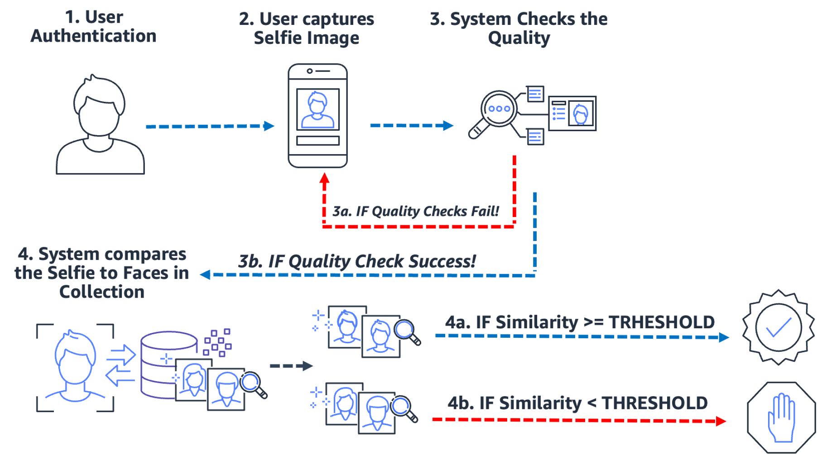
Notes:
Example workflow of using Roknition. More or larger collection of source material (such as images) means more comparisons for quality checking, resulting in greater accuracy or level of confidence.

Slide 13
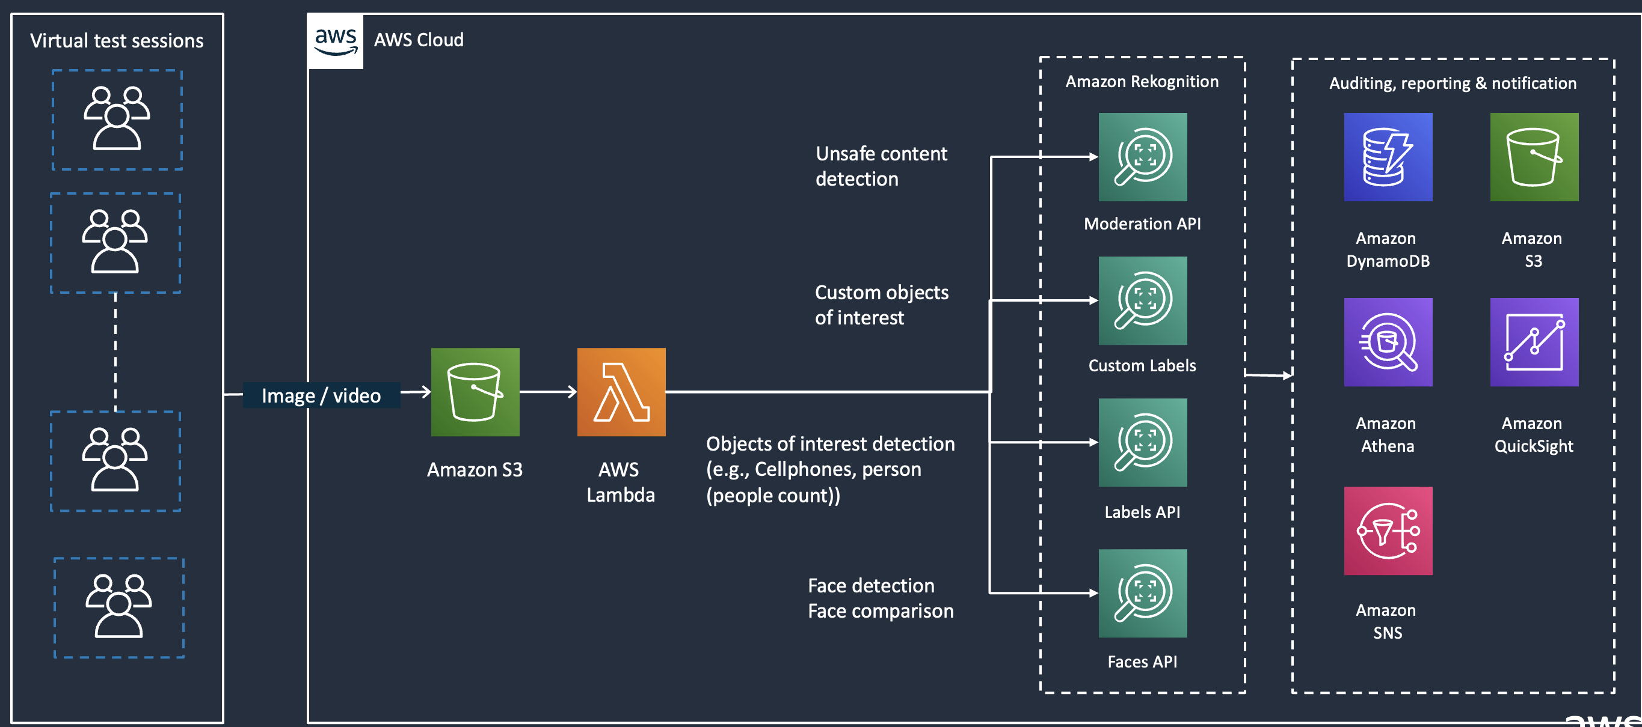
Reference Architecture – Virtual Proctoring

Slide 14
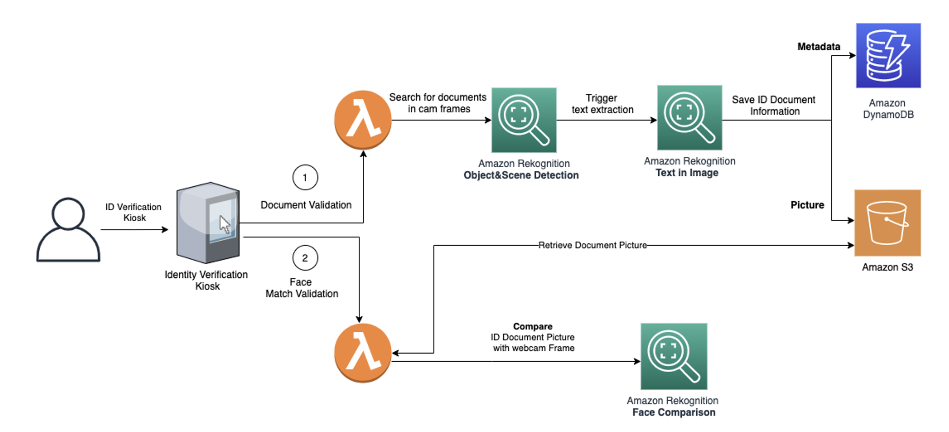
Identity Verification Reference Architecture - Computer Webcam

Slide 15
Auto Check-in Solution – Outside World

Slide 16
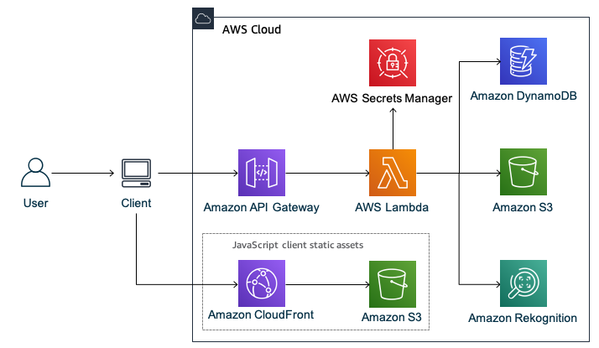
Liveness Detection Architecture – Mobile App

Slide 17
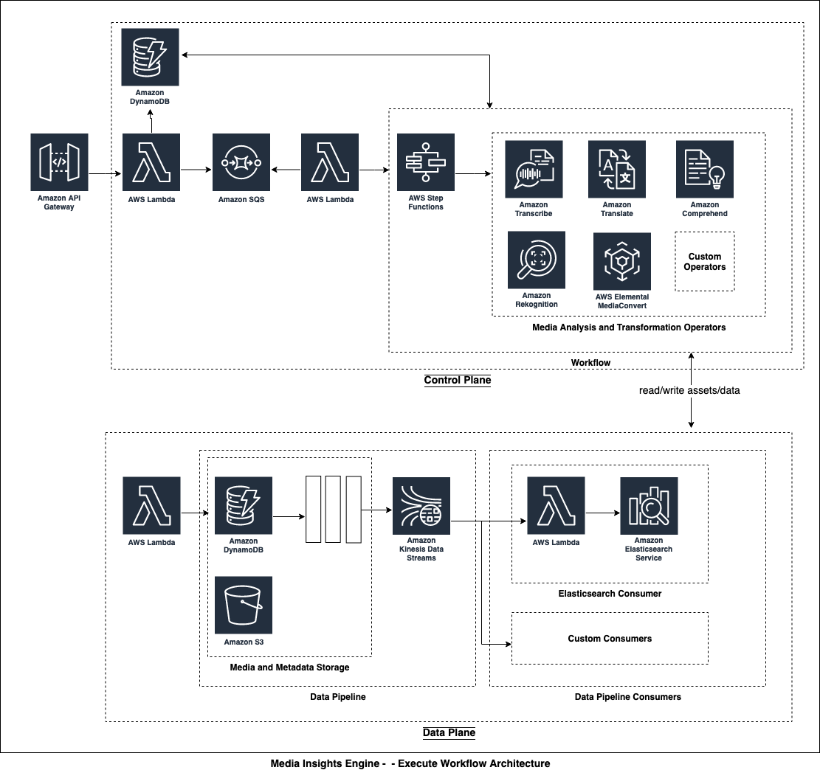
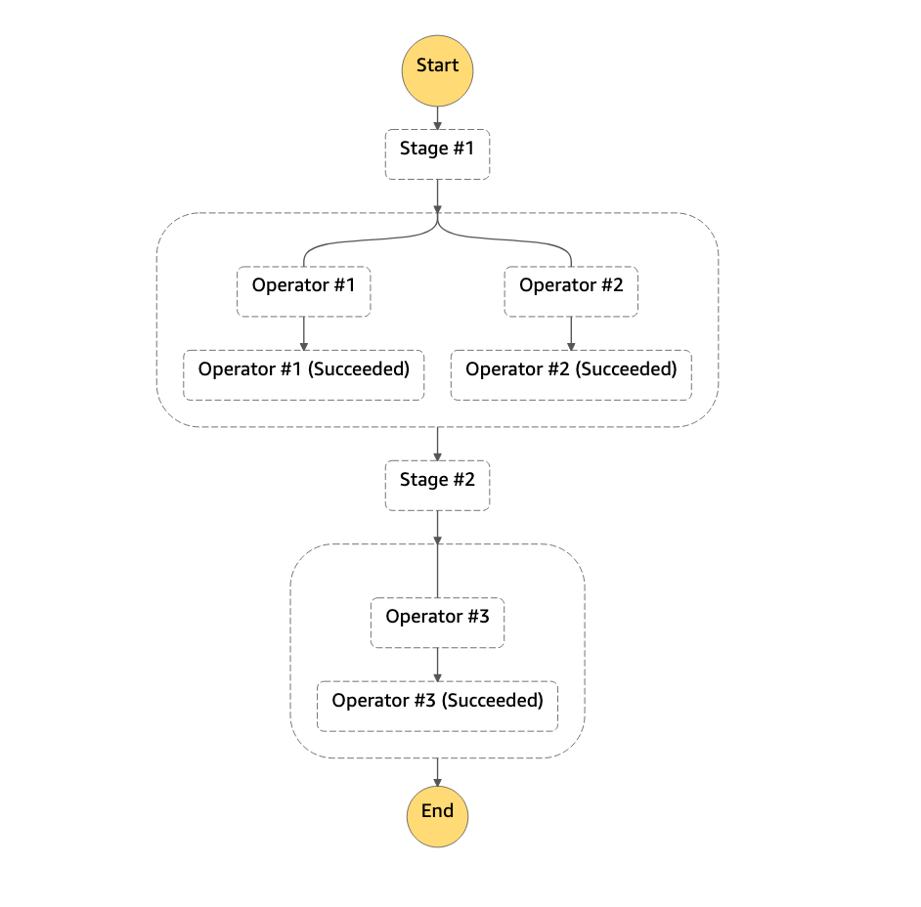
Reference Architecture – Content Moderation
Notes:
Key concepts
Control plane – executes the AWS Step Functions state machine execution for the workflow against the provided input
Data plane – store assets and metadata in various data consumers. Amazon S3, Amazon DynamoDB, Amazon Elasticsearch Engine, or other sources customizable through Kinesis Data Stream
Operators – a group of actions (lambdas) to perform a single task. For instance, Rekognition face detection task can compose of Start the face detection, Check the face detection status, and Get the face detection results. These actions are then grouped together to form an Operator. You can also see it as (a group of states within a state machine)
Stage – a group of Operators. A Stage consists of numbers of Operators that can be executed in parallel.
Workflow – a combination of Stages to form the final state machine execution.

Slide 18
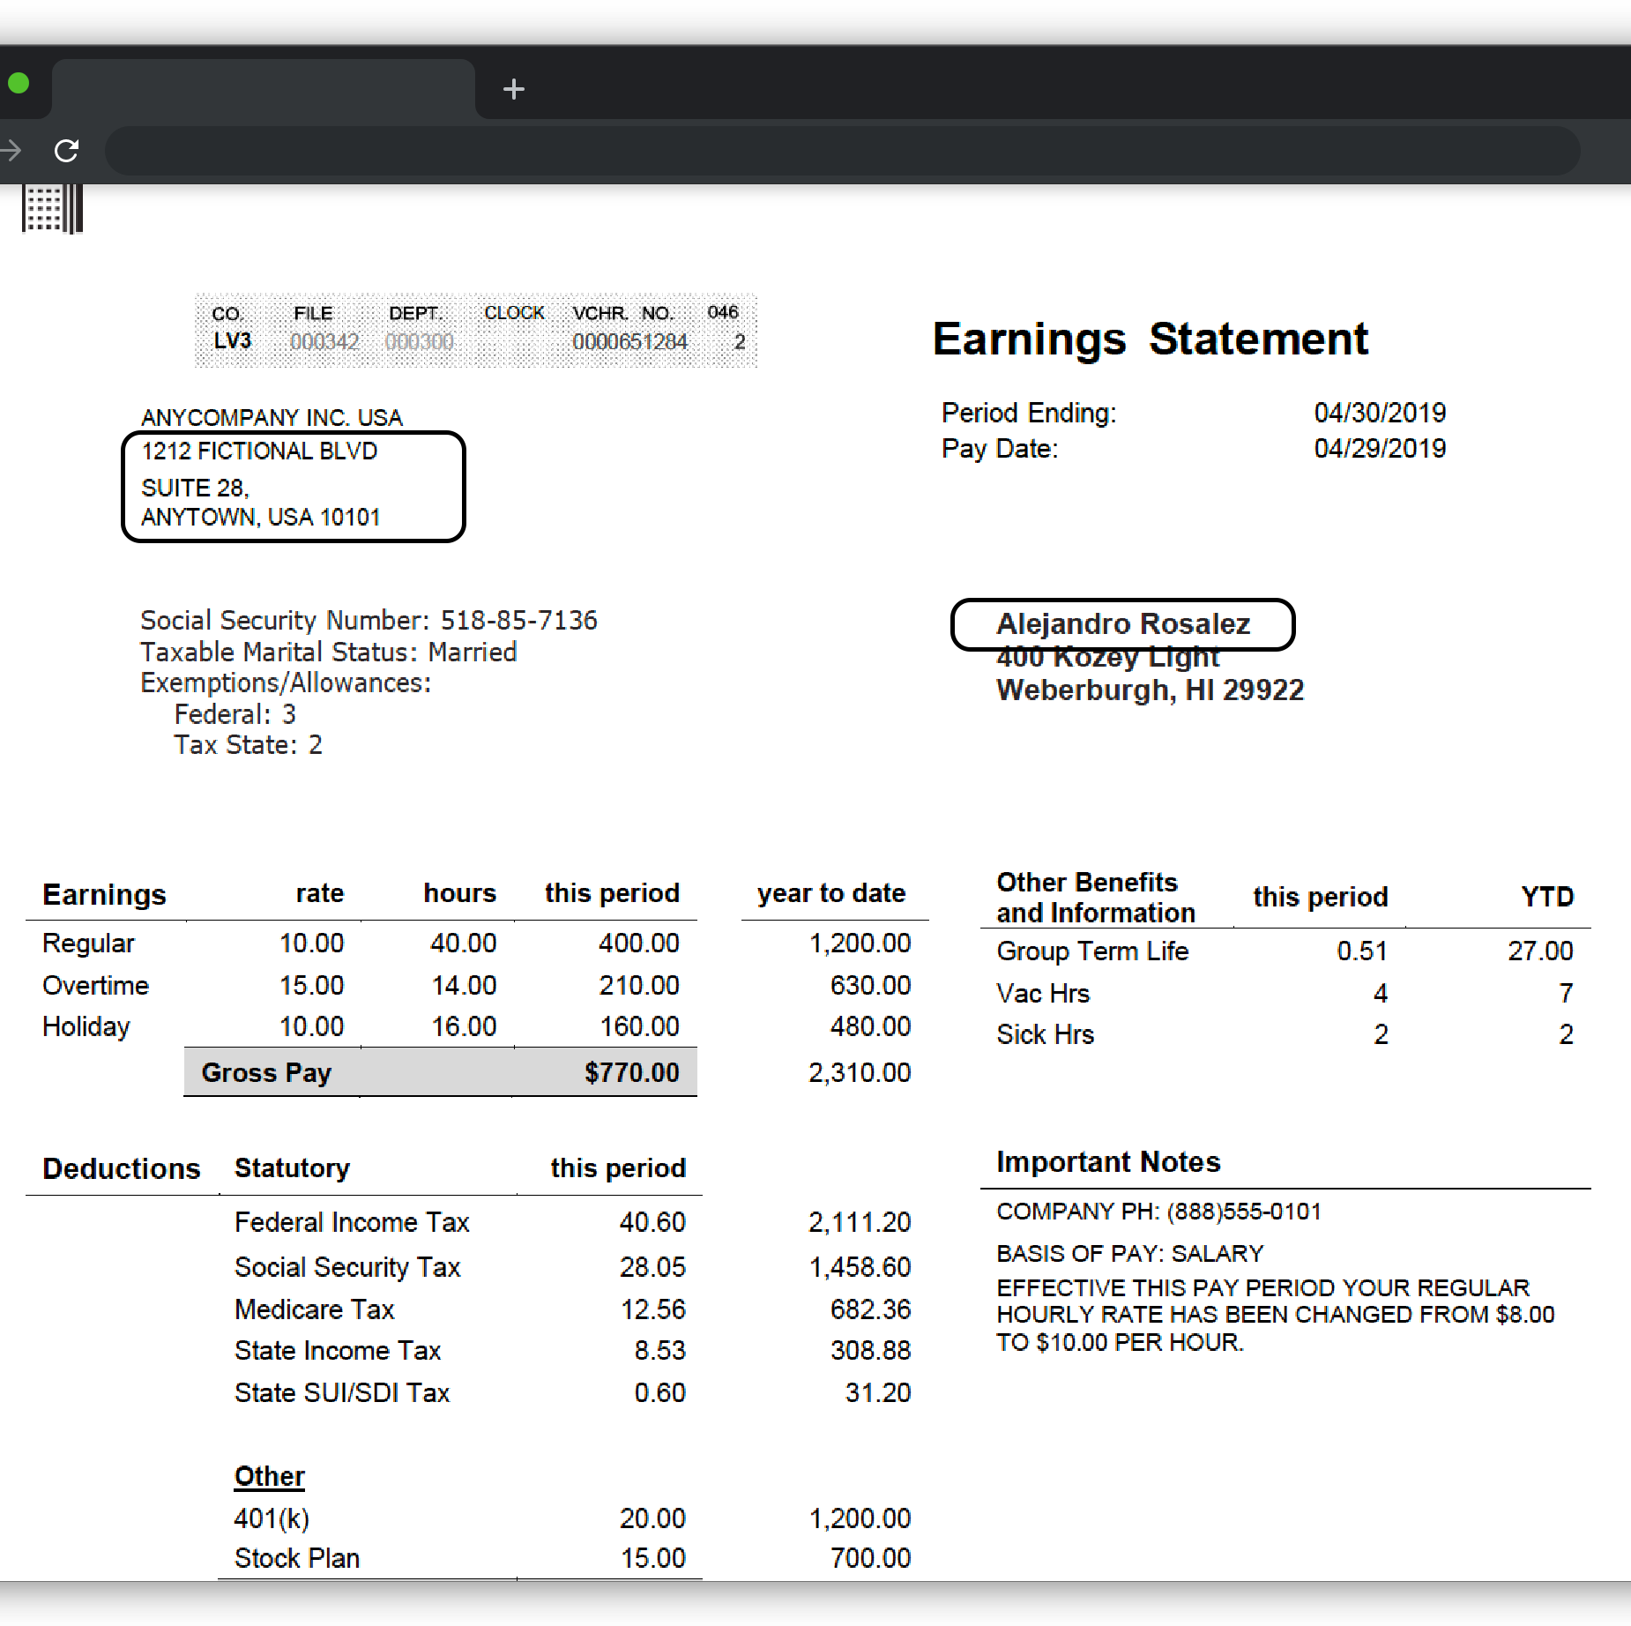
Amazon Comprehend
Uses natural language processing (NLP) to extract insights about the content of documents
Recognizes entities, key phrases, language, sentiments, etc.
Often used in combination with other services including Cognitive

Slide 19
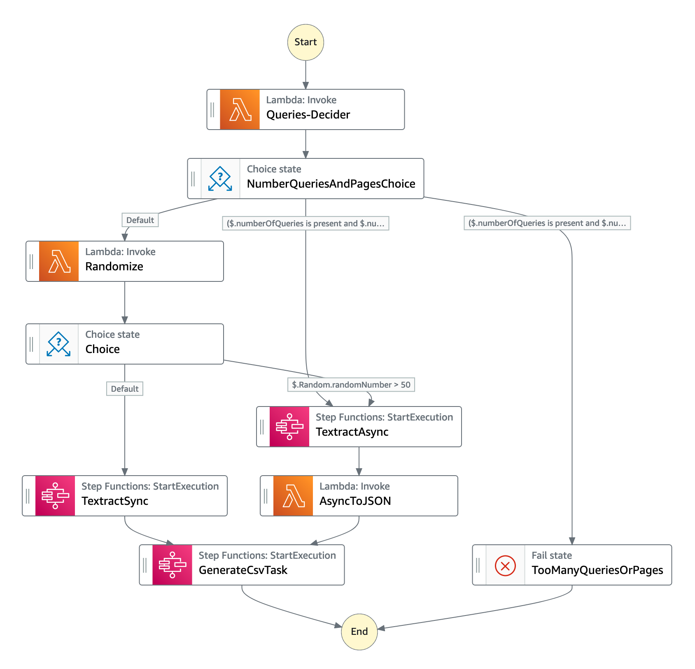
Notes:
Example Step Function expression of processing pay statement document image in previous slide

Slide 20
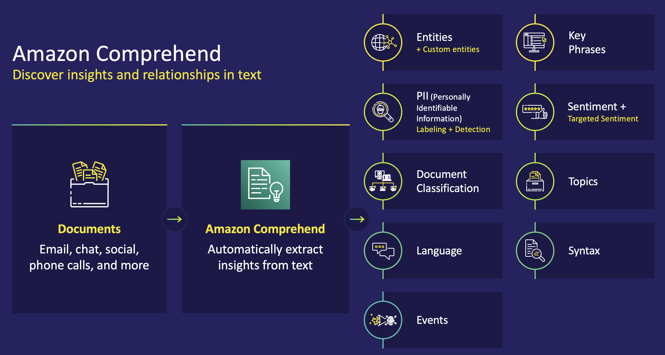
Notes:
Amazon Comprehend has pre-trained models that identify entities such as places, people, brands, or events; determine the language of the text; extract key phrases; understand how positive or negative the sentiment of text is; and automatically organize a collection of text files by topic.
However, customers have data that contains text that is very specific to their organization or business. They could have specific product names or document types. Therefore customers can train Comprehend to extract customer-specific entities or to assign specific labels to documents.
Vision Critical provides a customer relationship intelligence software that enable large enterprises to be fast, responsive, and customer-centric. By integrating with Amazon Comprehend’s sentiment analysis, their platform turns qualitative customer feedback into actionable insight, determining whether their feedback is positive, negative, or neutral at over 90% accuracy.
LexisNexis uses Comprehend’s custom entities recognition models to discover insights from legal documents. Entities such as judge and attorney, can be identified quickly from over 200 million documents at above 92% accuracy.

Slide 21
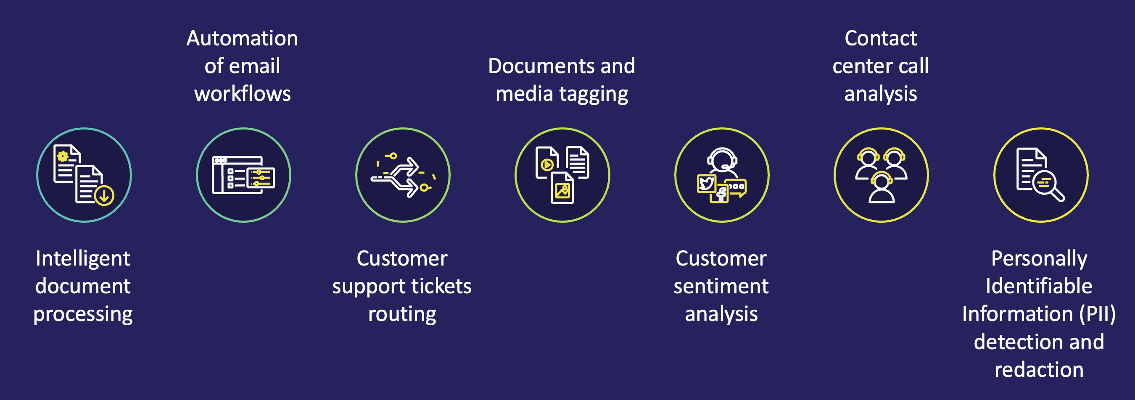
Amazon Comprehend typical use cases

Slide 22
Amazon Comprehend Applications
Sample Applications:
Faster insurance claims processing
Faster mortgage processing
Social media sentiment analysis
Notes:
Use cases:
Intelligent document processing:
Insurance claims documents (and the communication) come in various channels and forms with long paragraphs of text. This poses a challenge for humans to process. By combining text extraction (Amazon Rekognition!) and NLP (Amazon Comprehend), insurance companies process forms such as CMS-1500, binders, ACORD forms, and claims forms faster with higher accuracy*.
Mortgage/lending packets can come with many different types of forms such as W-2’s, bank statements, and deeds which make it difficult and time consuming to use traditional technologies for automation. Companies have reduced the 30-day by leveraging OCR and NLP processing to automate the extraction of the various documents, and processing
Assent: Combines technology and expertise to help their customers understand their supply chain data. To accomplish this, they needed a way to provide real-time classification of free-form compliance documents at scale. Their process is to extract semi-structured text from images and PDF's with forms and tables as well as extract custom entities within those documents. They use Amazon Textract's OCR technology to process the documents and Amazon Comprehend to extract custom entities. They also had the need to incorporate humans in their processing and used Amazon Augmented AI (Amazon A2I) to have their teams review documents in a given accuracy range and help train our next model iteration. Combining these services along with AppSync and Amplify provided them more accurate insights into customers supply chain risk in a shorter period of time saving our customers hundreds of hours in manually reviewing documents. Customers can now get immediate feedback on whether their company is at compliance risk.
FINRA is a not-for-profit organization authorized by Congress to protect America’s investors by making sure the broker-dealer industry operates fairly and honestly.
FINRA receives millions of documents with unstructured data to support investigative, examination, and compliance processes. Previously, investigators and examiners had to manually go through documents page by page to find what they needed.
FINRA uses Amazon Comprehend to quickly extract names of individuals and organizations, and match extracted entities to FINRA records, flag individual of interest, generate summaries, and detect similarities with other documents.
This exponentially increases the scope of investigations while shortening the time to conclusion.

Slide 23
Amazon Polly
Turn text into lifelike speech
Create applications that talk, and build interactive speech-enabled products
Used in combination with other services, especially Cognitive (Amazon Lex)
Example applications:
Alexa
Amazon Connect
Chatbots
Customer services
Turn-by-turn directions (Lyft Driver, and Uber Driver)
Notes:
Uses deep learning technologies to synthesize natural sounding human speech
Dozens of lifelike voices across a set of languages so you can build speech-enabled applications that work in different countries
Increases engagement and accessibility
Example:
aws polly synthesize-speech \
--language-code optional language code if needed
--output-format json \
--voice-id [name of desired voice] \
--text '[desired text]' \
--speech-mark-types='["viseme"]' \
LengthOfText.txt

Slide 24

Styles with NTTS
US English Matthew voice
US English Joanna voice
“Sources tell CNN he believes the media and the northeast elite are needlessly hyperventilating and overreacting to his comments.”
”President Donald Trump said on March 13 his administration was ordering the grounding of all Max 8 and 9 models, hours after Canada said it was grounding the planes after analyzing new satellite tracking data.”
STANDARD
NEURAL
NEWSCASTER
STANDARD
NEURAL
NEWSCASTER NTTS
Notes:
Here is a demonstration of the improvement from standard to neural.
Lets listen to the standard voice first.
Now neural.
Lets listen to how neural voices are further enhanced when speaking styles are introduced. Here, you can hear the improvement in voices as we move from standard to neural to neural newscaster speaking style.

Slide 25
AWS News Blog
https://aws.amazon.com/blogs/aws/aws-week-in-review-february-20-2023/

Slide 26

Q&A
Let’s demystify!
Notes:
Based on questions submitted by the specific batch
To be structured as a discussion
Mentor can share personal project experiences if needed
If applicable mentor can share any relevant cloud provider documentation link for further reading by the learners

Slide 27

Thank you
Happy Learning!

